Slide 2
KataLOn INtroduction
26 | 06 | 2015

Slide 3
Agenda
Business Opportunity/Problem
Vision Statement
Product Details
Distribution Model & Monetization
Progress Status
Katalon introduction

Slide 4
BUINESS OPPORTUNITY/PROBLEM
Katalon introduction

Slide 5
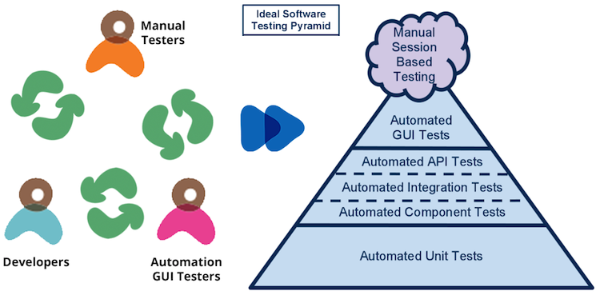
Business opportunity
Katalon introduction

Slide 6
Manual vs. Automated Testing
Manual Testing | Automated Testing
Not accurate at all times due to human error, hence it is less reliable. | More reliable, as it is performed by tools and/or scripts.
Time-consuming, taking up human resources. | Executed by software tools, so it is significantly faster than a manual approach.
Investment is required for human resources. | Investment is required for testing tools.
Only practical when the test cases are run once or twice, and frequent repetition is not required. | Practical when the test cases are run repeatedly over a long time period.
Allows for human observation, which may be more useful if the goal is user-friendliness or improved customer experience. | Does not entail human observation and cannot guarantee user-friendliness or positive customer experience.
Great for in/less-experienced scripting testers. | Great for experienced scripting testers.
Katalon introduction

Slide 7
VISION STATEMENT
Katalon introduction

Slide 8






Vision statement
 | An automated functional and regression testing platform to implement full automated testing solutions with reduced and minimal engineering and programming skill requirements.
 | Designed to be used both by experts in test automation as well as those that are new to the concept.
 | User’s need to boost the automated testing productivity with ease by: Minimize the effort to create and maintain automated test scripts Facilitate team work Centralize test management
 | Easy to start with inexperienced scripting testers with keyword-driven approach but increase unlimited capability solving complexity problem with scripted or mixed approach Customizable & extensible
 | Affordable price, can be free with consulting services or sold as stand alone Can be given to clients without the need for ongoing source code access or maintenance by clients
 | TBD for roadmap, but: Start of 2016 to release the first two components Start of 2017 to release the remaining two components
Katalon introduction
Notes:
2/. Who:
Target users:
Non-scripting experienced and automated test engineers
Target customers:
Company who wants to do automated testing for their software products
Especially, company who wants to leverage non-scripting skilled testers to do automation
Target monetized customers would be enterprise companies not ISVs

Slide 9
MARKET analysis
Katalon
Katalon introduction

Slide 10
PRODUCT DETAILS
Katalon introduction

Slide 11
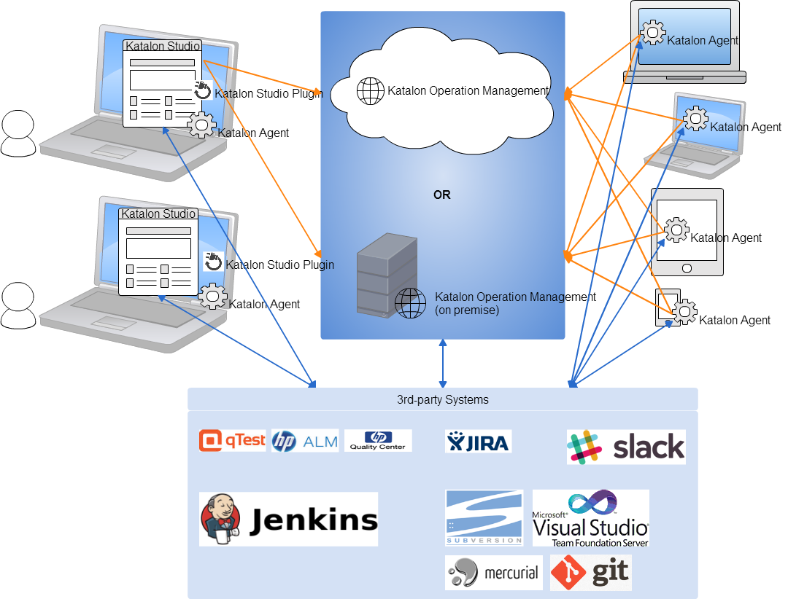
Product overview
Katalon introduction

Slide 12
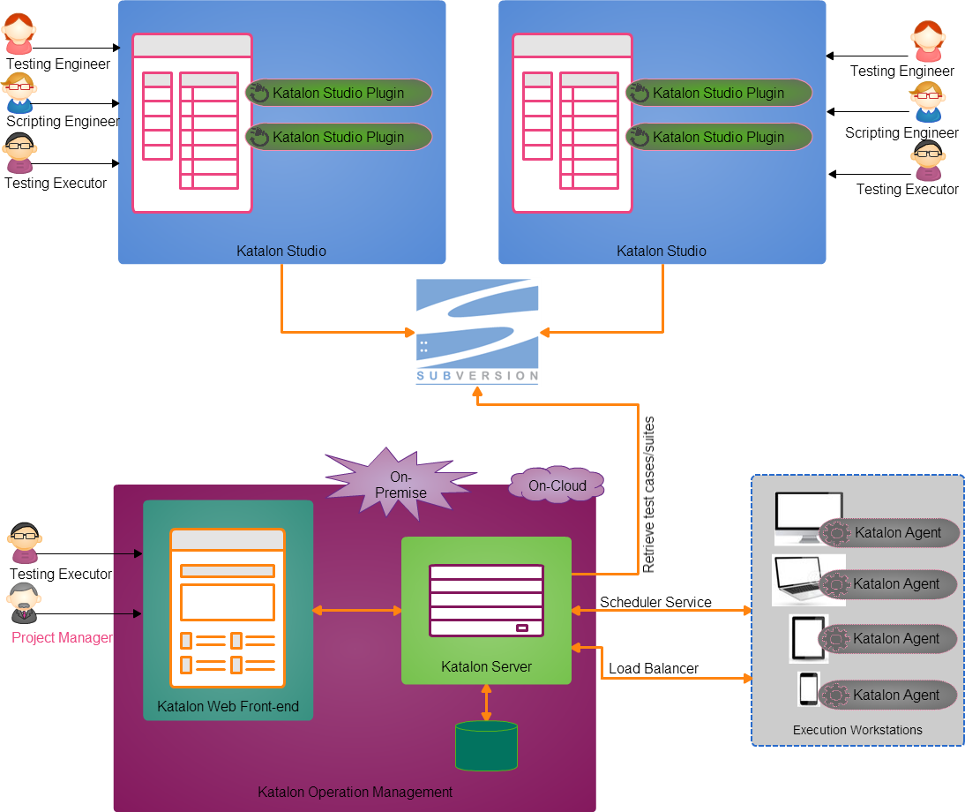
Product Architecture
Katalon introduction

Slide 13
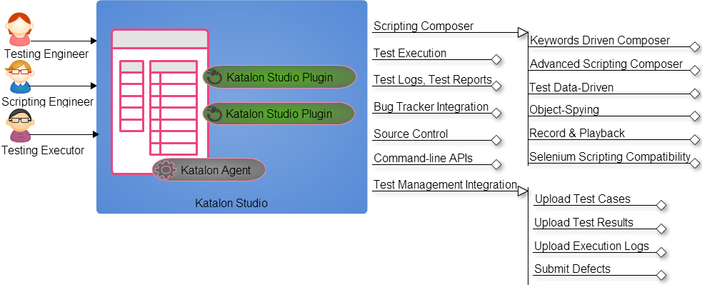
Katalon Studio
Katalon introduction

Slide 14
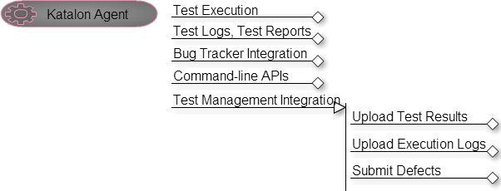
Katalon agent
Katalon introduction

Slide 15
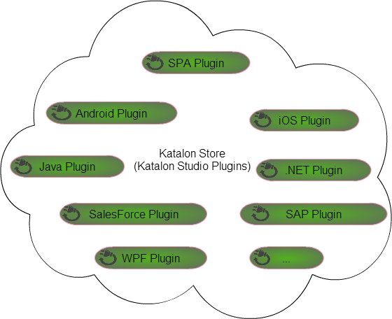
Katalon store
Katalon introduction

Slide 16
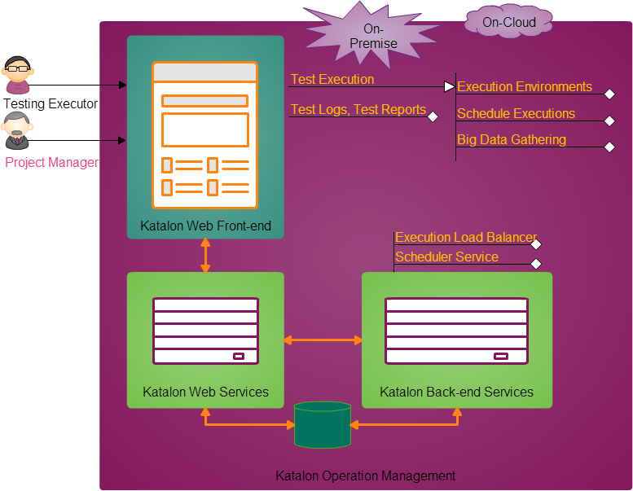
Katalon Operation Management
Katalon introduction

Slide 17
DISTRIBUTION MODEL & MONETIZATION
Katalon introduction

Slide 18
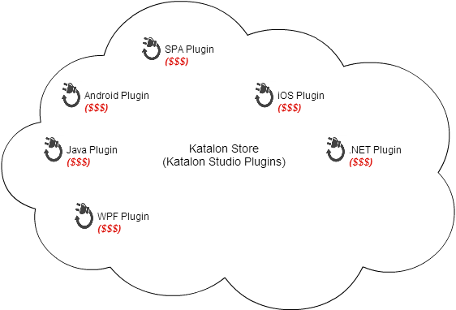
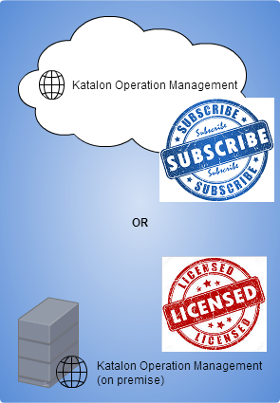


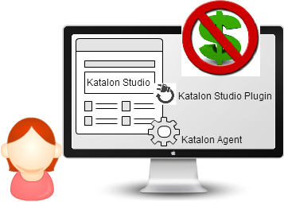
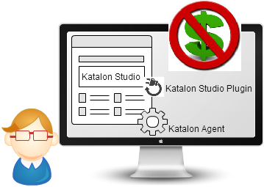
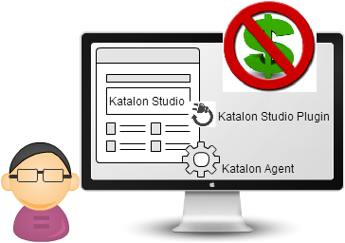

How to release Katalon
Katalon vision

Slide 19
PROGRESS STATUS
Katalon introduction

Slide 20
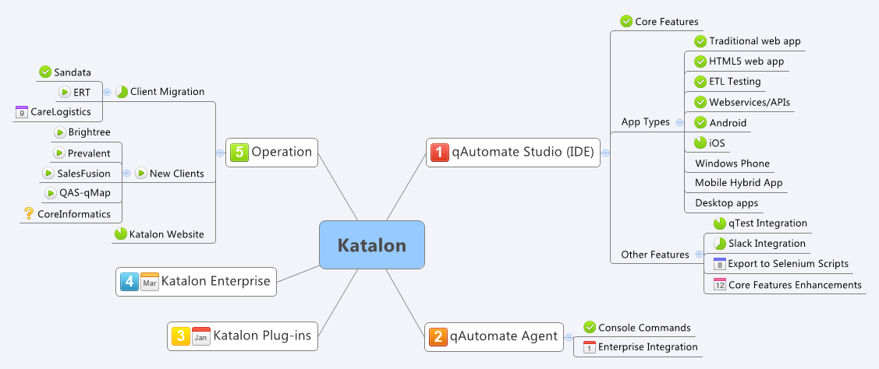
Katalon stat by may 2015
Katalon introduction

